Slide 1
5COSC020W DATABASE SYSTEMS – LECTURE 11
NoSQL Databases and Document-oriented Databases

Slide 2
Lecture 11 – Outline
NoSQL paradigm
Definition.
Motivations and need for an alternative to relational databases.
Distributed databases.
Features of NoSQL databases.
Document-oriented databases
Definition, collection, documents, name-value pairs.
JSON: JavaScript Object Notation.
MongoDB
BSON: Binary JSON.
Examples of possible designs.
CRUD operations.

Slide 3
Classifying DBMSs based on Data Models (Recap)
Relational Model or SQL Model (covered in lectures 01-07)
Structured Data as collection of tables with fields, records, PKs and FKs.
Uses high level Structured Query Language (SQL) for CRUD operations.
XML Model (covered in lectures 08-10)
Semi-structured data as elements that can be nested to create tree structures.
Standard for structuring and exchanging data over the Web.
NoSQL Model (covered in lectures 11)
Key-value data model: each data value associated to unique key for fast retrieval.
Graph data model: data represented as graphs i.e. labelled nodes and edges.
Document data model: data as collection of documents in JSON or XML.
Object Model (not covered in this module)
Data as collection of objects (in classes) with properties & operations.

Slide 4
The NoSQL Database Paradigm
NoSQL = “Non-SQL” or “Not Just SQL”
Approach to database design that enables the storage and querying of data outside the traditional tabular structures found in relational databases.
Non-relational
Variety of data models: document, key-value, columnar and graph formats.
Distributed
Information copied and stored on various servers, remote or local.
Scalable
Accommodate evolving data workloads in Big Data or real-time web apps.
Flexible
Manage large data sets without a fixed structure, schema-less.

Slide 5
Need for an alternative to the relational model
Big Data and real-time web apps.
Huge amount of data distributed over many different systems.
Increase of the data needs of organisations.
Examples:
Email and Personal Information Manager web app: Gmail, Outlook, etc. :
Millions of users, thousands of messages, attachments, calendar entries, meeting requests, alerts, etc.
Social Media Platforms: Facebook, Twitter, Instagram, etc.
Millions of users, thousands of posts with images and videos.
Posts displayed on others‘ pages with whom user has a social media relationship.
Huge collection of data stores to store: profiles, social media relationship & relevant subscribed posts.
Need for a new database paradigm to handle distributed Big Data
Structured data model is too restrictive.
Traditional transactional relational systems not always suitable for huge systems.
Need for multiple types of new databases!

Slide 6
Motivations for NoSQL Databases
Scalability
Ability to efficiently meet the needs for varying workloads.
Ability to scale up (add extra nodes) and down (remove nodes) to handle continuously evolving traffic (node = computer site).
Cost
Use of free & open-source database systems to handle unpredictable workloads.
Flexibility
Ability to handle data that does not have a fixed structure but that is semi-structured or unstructured instead e.g. different attributes for different items.
Availability
Ability to handle large amounts of data distributed over multiple nodes to make ensure it is available at all time even when nodes are down for maintenance.

Slide 7
Distributed Databases
Collection of multiple logically interrelated databases distributed over a computer network.
Interconnection of database nodes
Databases stored on multiple nodes interlinked by an underlying network to transmit data and commands.
Logical interrelation of the connected databases
Information stored on the connected database nodes must be logically related.
No homogeneity of data between connected nodes
No homogeneity among the connected database nodes in terms of data, hardware and software.

Slide 8
Features of NoSQL DBMSs (related to Distributed Databases)
Scalability
As data grows, capability to add new nodes for increased data storage and processing without interrupting system operations.
Availability, replication and eventual consistency
Capability to provide continuous system availability by replicating data over nodes.
Improved performance of read requests as they are serviced by multiple nodes.
Worsening performance of write requests as update applied to every copy of a data item.
Weaker consistency level is often acceptable.
Sharding of files (aka horizontal partitioning)
Ability to distribute the load of accessing records to multiple nodes.
Works in tandem with replication to improve load balancing and data availability.
High-performance data access
Ability to partition data items in independent parts and use a partition key to assign the key to a partition and retrieve the partition based on specific criteria.

Slide 9
Features of NoSQL DBMSs (Data Models & Query Languages)
Schema-less
Ability to store semi-structured and self-describing data using JSON or XML.
Schema not required ; partial schema can be used to improve storage efficiency.
No referential integrity, no joins.
Constraints on the data have to be programmed in the application programme.
Less Powerful Query Languages
SCRUD (Search, Create, Read, Update, Delete) operations tend to involve one object stored in a single file using object key, no complex querying.
API (Application Programming Interface)
Implements read and write operations.
Low-level data manipulation & selection methods.
Possibility of basic high-level not standardised query language, without joins.

Slide 10
Document-Based or Document-Oriented NoSQL DBMSs
Data stored as collection of similar documents (or document stores).
Documents
Similar to XML documents but no need to specify a schema (e.g. tree structure).
Self-describing data: documents contain the structure information and the data.
Collection of name-value pairs.
Name: indicates the attribute.
Value: data assigned to that attribute.
Basic data types e.g. numbers, strings, and Booleans.
Structures e.g. arrays, objects
Formats
XML: Extensible Markup Language.
JSON: JavaScript Object Notation.

Slide 11
JSON – JavaScript Object Notation
JSON
Open standard file and data interchange format to store and transmit data consisting of attribute–value pairs and arrays.
Language-independent data format.
Originally derived from JavaScript.
JSON Syntax rules
Documents consist of name-value pairs.
Names are strings e.g. Pname and Plocation for a Project.
Values can be:
Numbers: decimal numbers.
Strings: delimited with double-quotation marks.
NULL: empty values.
Arrays: ordered list of elements.
Objects: collection of name-value pairs. No restrictions on the names, uniqueness
and ordering.

Slide 12
MongoDB – a Document-Based DBMS
MongoDB
Cross-platform document-oriented DBMS.
Distributed database as its core.
Schemas are optional: fields can vary and data structure can be changed.
Data stored in collections of JSON-like documents: BSON.
BSON: Binary JSON
Binary representation to store data in JSON format, optimized for speed, space, and flexibility.
Capacity to query and manipulate objects by specific keys inside the JSON/BSON document, even in nested documents many layers deep.
More sophisticated numeric types.
Additional non-JSON-native data types e.g. dates and binary objects.

Slide 13
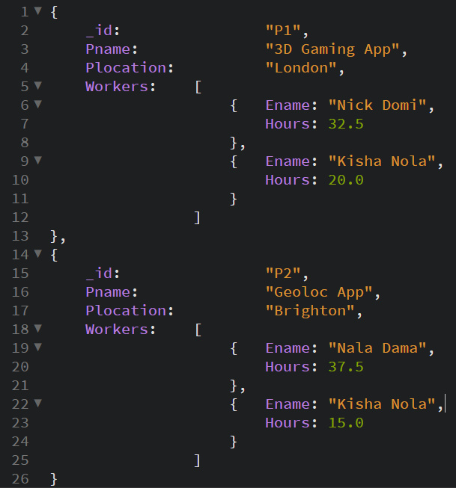
MongoDB Design Example 1
Design 1: Project Document with embedded array of Workers
Denormalized design.
Similar to a XML document.
1 collection
Project collection contains project docs with workers info within them.
Identifiers
Docs whose _id start with P: Projects.
Interrelation
Workers information stored in an array embedded within the project doc.

Slide 14
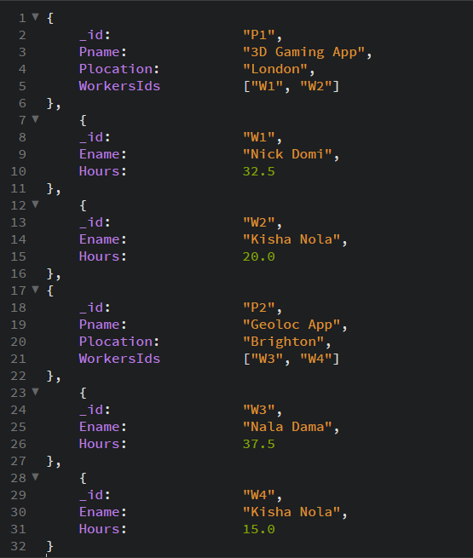
MongoDB Design Example 2
Design 2: Project doc with embedded array of Worker IDs
Denormalized design.
2 collections
Project collection contains project docs.
Worker collection contains worker docs
Identifiers
Docs whose _id start with P: Projects.
Docs whose _id start with W: Workers.
Interrelation:
Worker references stored in an array embedded within the project doc.

Slide 15
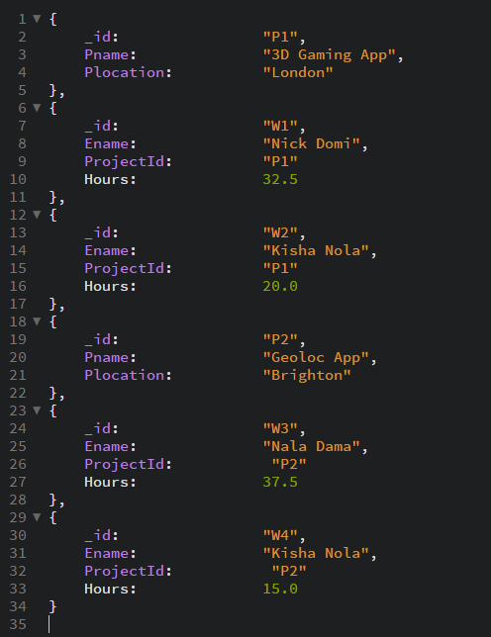
MongoDB Design Example 3
Design 3: “Normalized” documents
Pseudo-normalized design, almost like a M:M.
2 collections
Project collection contains project docs.
Worker collection contains worker docs.
Identifiers
Docs whose _id start with P: Projects.
Docs whose _id start with W: Workers.
Interrelation:
Multiple worker docs with different IDs to represent workers working on specific project.

Slide 16
CRUD Operations in MongoDB
CREATE
Insert operation: db.collection_name.insert(document)
Uses single docs or array of docs.
READ
Find operation: db.collection_name.find(condition)
Boolean condition on docs in the collection, docs that return true are retrieved.
UPDATE
Update operation db.collection.update(selection, updated_data)
Condition to select certain documents and clause to specify the update.
DELETE
Remove operation: db.collection_name.remove(condition)
Boolean condition on docs in the collection, docs that return true are removed.

Slide 17
References and Essential Readings
Elmasri, R. & Navathe, S. (2017). Fundamentals of Database Systems. 7th Edition (Global Edition). Pearson Education.
IBM Cloud Education (2019). NoSQL Databases. Available from https://www.ibm.com/cloud/learn/nosql-databases [Accessed 30 May 2021]
MongoDB (2021). MongoDB Manual. Available from https://docs.mongodb.com/manual/introduction/ [Accessed 30 May 2021]
Sullivan, D. (2015). NoSQL for Mere Mortals. 1st Edition. Addison-Wesley Professional.

Slide 18
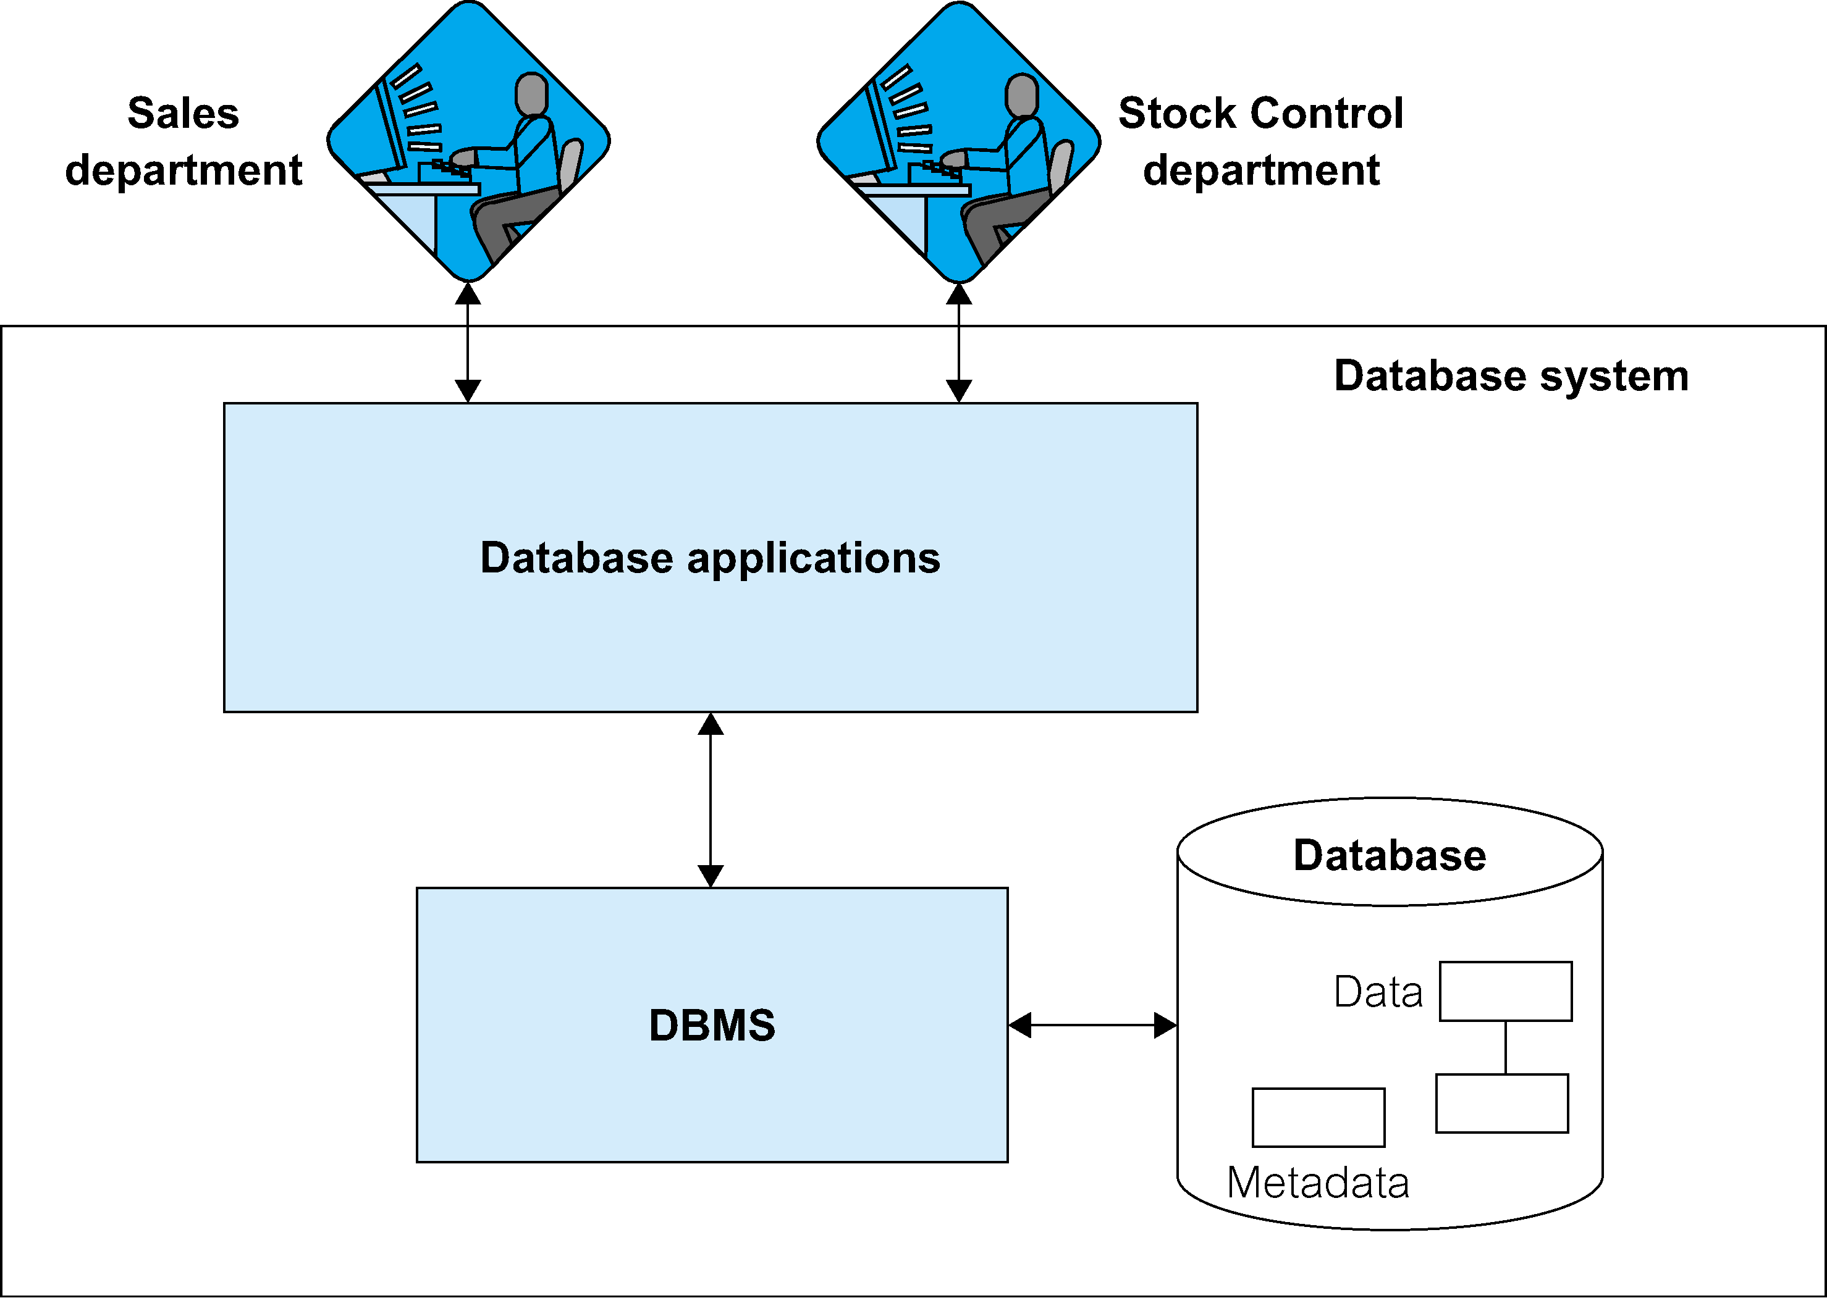
Database System
5COSC024W
Server-side
Web Development
5COSC024W
Server-side
Web Development
5COSC020W
DATABASE
SYSTEMS
5COSC020W
DATABASE
SYSTEMS

